Slide 1
Everyday performance fuckups
Łukasz Pyrzyk

Slide 2
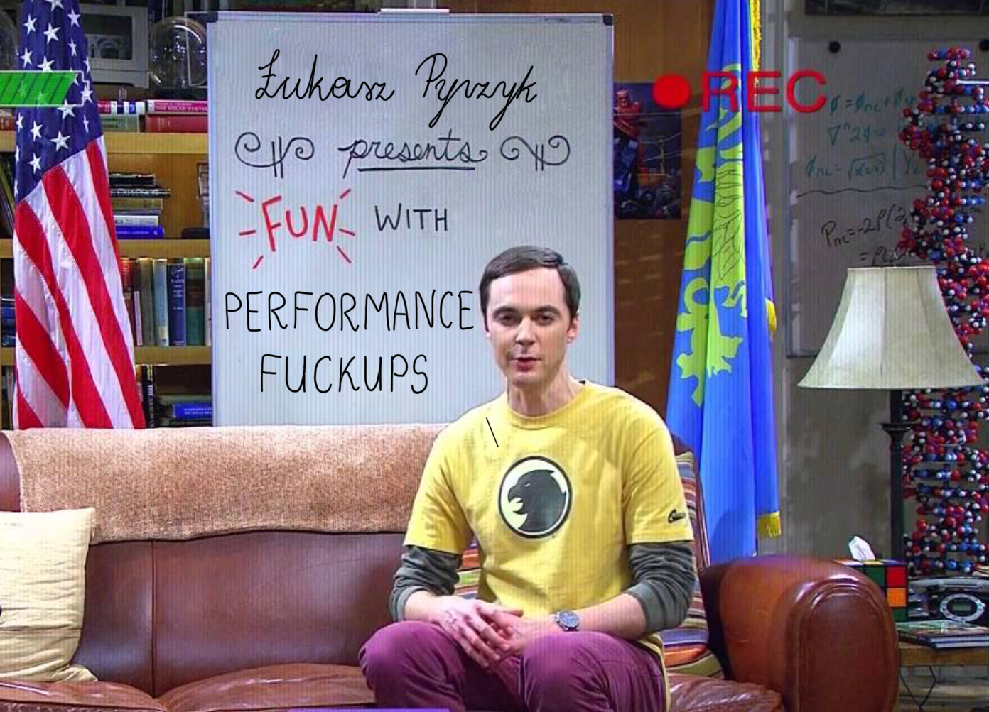
Everyday performance fuckups
Łukasz Pyrzyk

Slide 3

Łukasz pyrzyk
Co-founder of Dotnetos
Microsoft MVP
Senior Full Stack Cloud Developer at Sonova/JCommerce​
Tweets as @lukaszpyrzyk

Slide 4
issue #0
preparing 100 slides for 45 minutes talk
@lukaszpyrzyk

Slide 5
issue #1 Assuming performance improvement
@lukaszpyrzyk

Slide 6
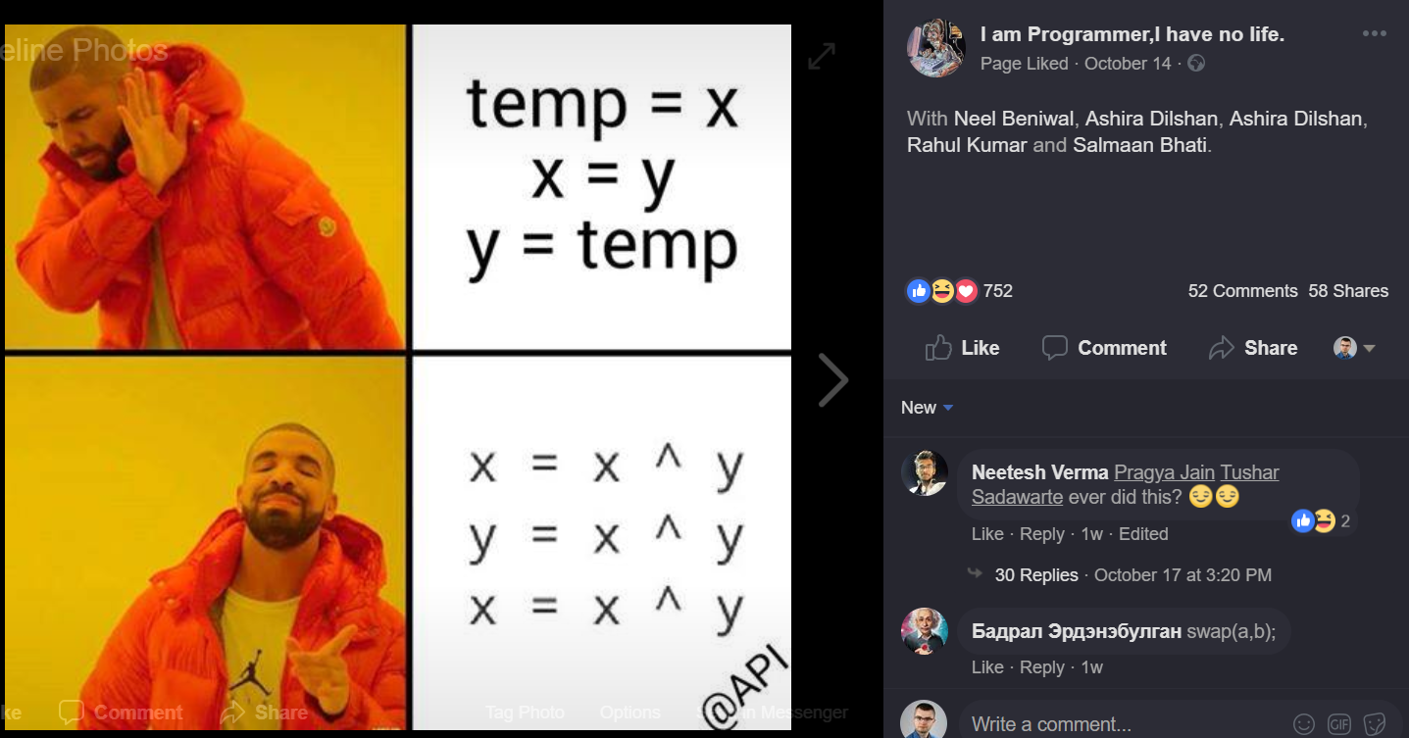

Slide 7

public void XOR(ref int x, ref int y)
{
x = x ^ y;
y = x ^ y;
x = x ^ y;
}
No temp int variable
int is 4 bytes, so it saves 4 bytes
Assembly has XOR operation, so it’s 1:1, so it’s fast
@lukaszpyrzyk

Slide 8
Method | Mean | Error | StdDev | Median
XOR | 2.8275 ns | 0.0615 ns | 0.0575 ns | 2.8419 ns
@lukaszpyrzyk

Slide 9
Method | Mean | Error | StdDev | Median
XOR | 2.8275 ns | 0.0615 ns | 0.0575 ns | 2.8419 ns
TempVariable | 0.0114 ns | 0.0131 ns | 0.0123 ns | 0.0000 ns
0.0000 ns
The method duration is indistinguishable from the empty method duration
Requires Benchmarkdotnet v0.11.2+
@lukaszpyrzyk

Slide 10
Getting assembly from c#
sharplab.io by Andrey Shchekin
The Ultimate .NET Experiment (TUNE) by Konrad Kokosa
DisassemblyDiagnoser in BenchmarkDotNet
Disasmo by Egor Bogatov
@lukaszpyrzyk

Slide 12
XOR
00007ff9`b7092140 418b00 mov eax,dword ptr [r8]
00007ff9`b7092143 3102 xor dword ptr [rdx],eax
00007ff9`b7092145 8b02 mov eax,dword ptr [rdx]
00007ff9`b7092147 413100 xor dword ptr [r8],eax
00007ff9`b709214a 418b00 mov eax,dword ptr [r8]
00007ff9`b709214d 3102 xor dword ptr [rdx],eax
00007ff9`b709214f c3 ret
TempVariable
00007ff9`b70b2140 8b02 mov eax,dword ptr [rdx]
00007ff9`b70b2142 418b08 mov ecx,dword ptr [r8]
00007ff9`b70b2145 890a mov dword ptr [rdx],ecx
00007ff9`b70b2147 418900 mov dword ptr [r8],eax
00007ff9`b70b214a c3 ret
@lukaszpyrzyk

Slide 13
public void AddAndSubtract(ref int x, ref int y)
{
x = x + y;
y = x - y;
x = x - y;
}
@lukaszpyrzyk

Slide 14
Method | Mean | Error | StdDev | Median
XOR | 2.8275 ns | 0.0615 ns | 0.0575 ns | 2.8419 ns
TempVariable | 0.0114 ns | 0.0131 ns | 0.0123 ns | 0.0000 ns
AddAndSubtract | 2.8454 ns | 0.0691 ns | 0.0646 ns | 2.8798 ns
@lukaszpyrzyk

Slide 15
TIP “Swap two variables without using temp variable” popular interview question
@lukaszpyrzyk

Slide 16
Issue #2 benchmarking done wrong
@lukaszpyrzyk

Slide 17

@lukaszpyrzyk

Slide 18
public void M()
{
int x = 4096, y = 8192;
x = x ^ y;
y = x ^ y;
x = x ^ y;
Console.WriteLine(x);
Console.WriteLine(y);
}
@lukaszpyrzyk

Slide 19
public void M()
{
int x = 4096, y = 8192;
int temp = x;
x = y;
y = temp;
Console.WriteLine(x);
Console.WriteLine(y);
}
@lukaszpyrzyk

Slide 20
Benchmarking….
@lukaszpyrzyk

Slide 21
It is the same!
@lukaszpyrzyk

Slide 22
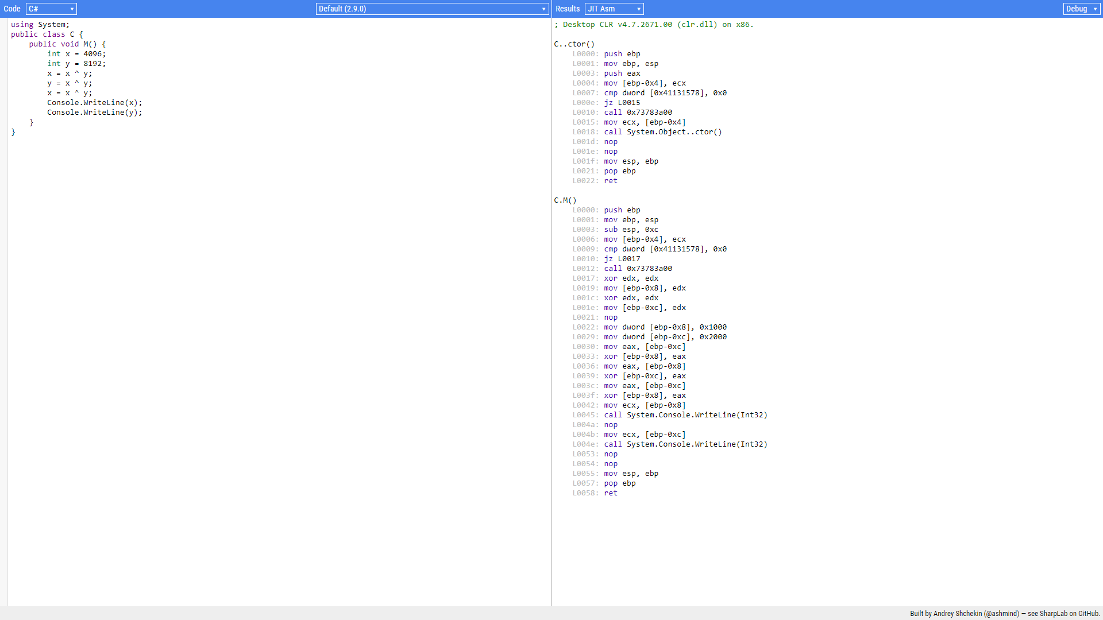
Debug assembly 30 lines

Slide 23
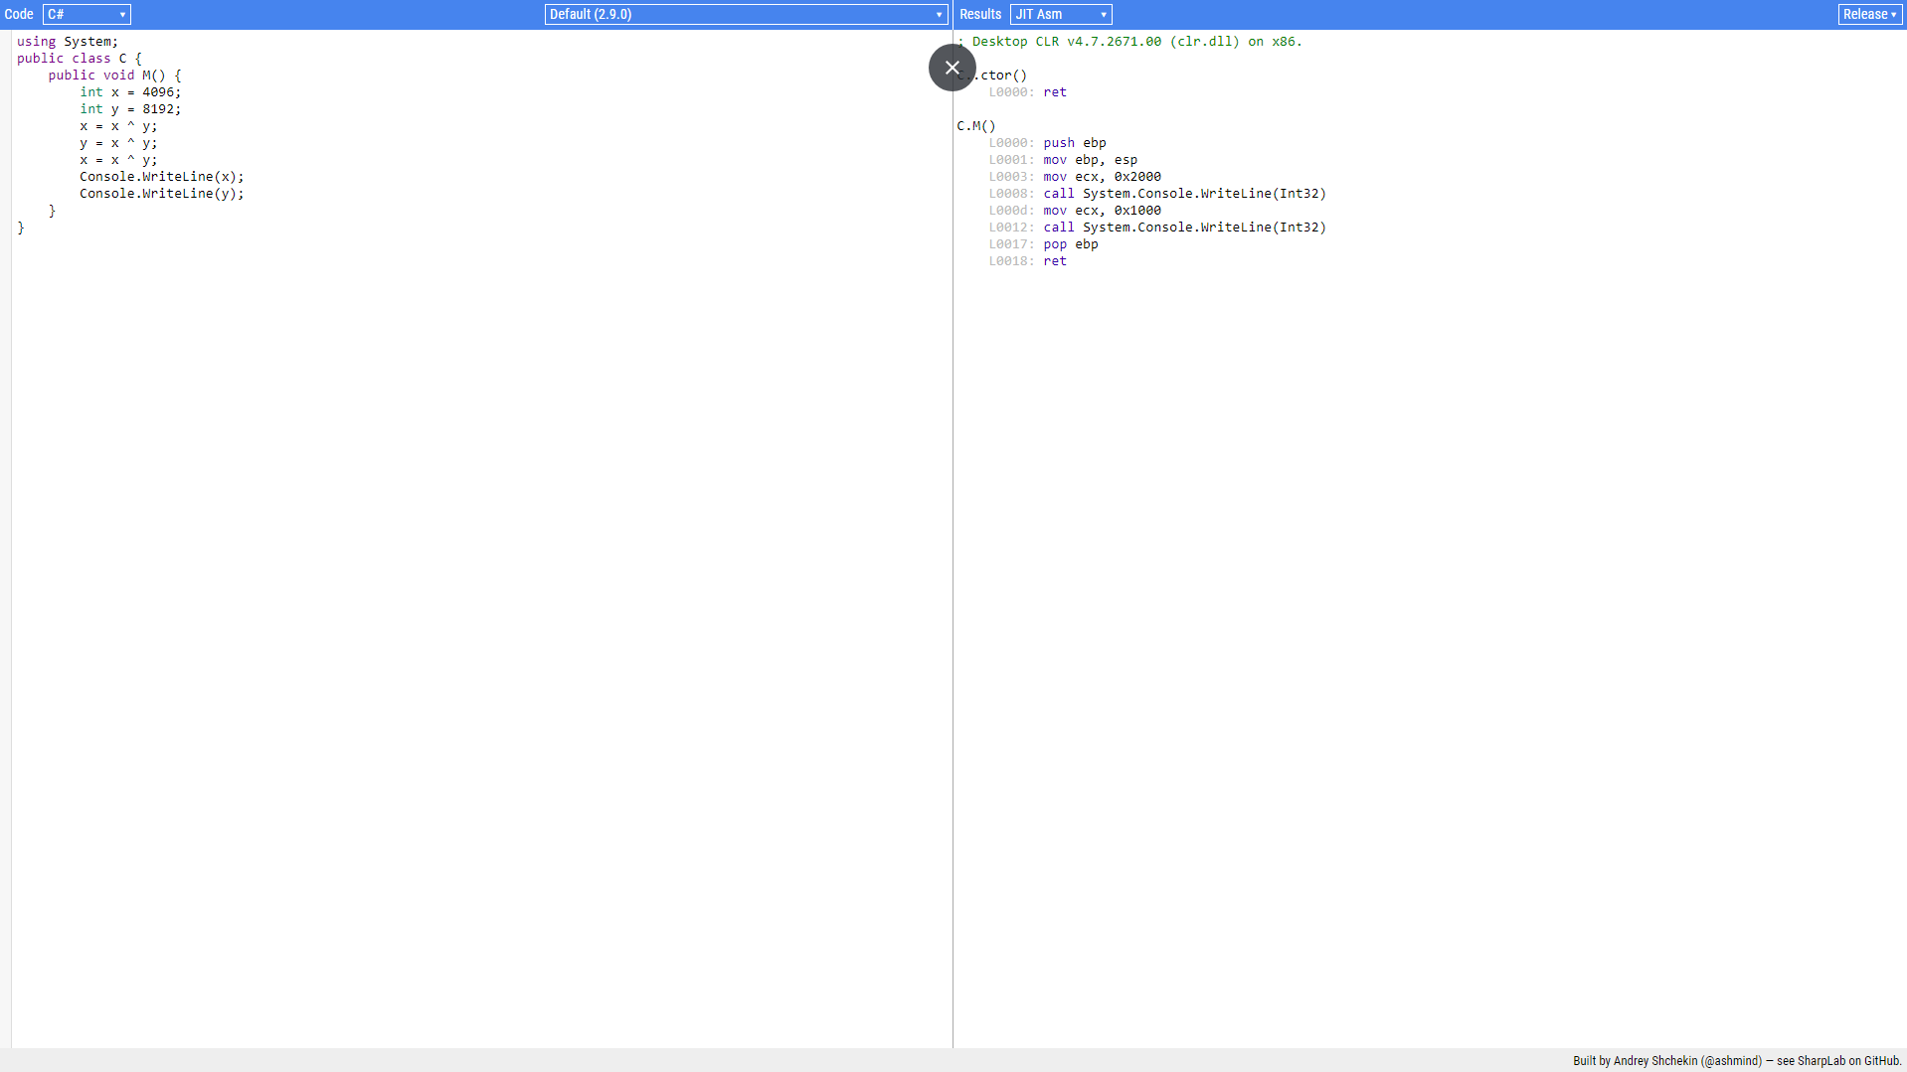
Release assembly 8 lines

Slide 24
Issue #3 Releasing product in debug mode
@lukaszpyrzyk

Slide 25
@lukaszpyrzyk

Slide 26
YAML
YAMLDOTNET
@lukaszpyrzyk

Slide 27
Previous yamldotnet benchmarks
foreach(var test in tests)
{
Console.Write("{0}\t{1}\t", adapterName, test.GetType().Name);
var graph = test.Graph;
RunTest(serializer, graph); // warmup
if (!Stopwatch.IsHighResolution) Console.Error.WriteLine("Stopwatch is not high resolution!");
var timer = Stopwatch.StartNew();
for (var i = 0; i < iterations; ++i)
RunTest(serializer, graph);
var duration = timer.Elapsed;
Console.WriteLine("{0}", duration.TotalMilliseconds / iterations);
}

Slide 28
Attemp with benchmarkdotnet
[MemoryDiagnoser]
public class ReceiptTest
{
private readonly Receipt _receipt = new Receipt();
private readonly StringWriter _buffer = new StringWriter();
private readonly ISerializer _serializer = new SerializerBuilder()
.WithNamingConvention(new CamelCaseNamingConvention())
.Build();
[Benchmark]
public void Serialize()
{
_serializer.Serialize(_buffer, _receipt.Graph);
}
}

Slide 29
dotnet run –c Release
// Validating benchmarks:
Assembly YamlDotNet.PerformanceTests.vlatest which defines benchmarks references non-optimized YamlDotNet
- If you own this dependency, please, build it in RELEASE.
- If you don't, you can create custom config with DontFailOnError to disable our custom policy and allow this benchmark to run.

Slide 30
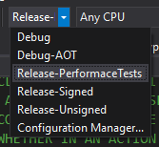
problem
New csproj format doesn’t have the same behaviour as the old one. Configurations like Release-* don’t inherit from Release configuration.

Slide 31
fix
<PropertyGroup Condition=" '$(Configuration)' == 'Release-Signed' Or '$(Configuration)' == 'Release-Unsigned' ">
<DefineConstants>$(DefineConstants);RELEASE;TRACE</DefineConstants>
<DebugSymbols>false</DebugSymbols>
<DebugType>portable</DebugType>
<Optimize>true</Optimize>
</PropertyGroup>

Slide 32
fix
-----------------------------------------------------------------------------------
| | Mean | Error | StdDev | Gen0 | Gen1 | Allocated |
-----------------------------------------------------------------------------------
| v1.2.1 | 128.7 us | 1.285 us | 1.202 us | 5.8594 | 0.2441 | 23.66 KB |
| v2.2.0 | 240.6 us | 3.467 us | 3.243 us | 18.0664 | 0.4883 | 60.03 KB |
| v2.3.0 | 307.9 us | 6.112 us | 10.21 us | 20.0195 | 0.4883 | 67.32 KB |
| v3.8.0 | 292.2 us | 4.225 us | 3.952 us | 21.4844 | 0.4883 | 70.82 KB |
| v4.0.0 | 283.2 us | 3.075 us | 2.876 us | 22.9492 | 0.4883 | 74.26 KB |
| v5.2.1 | 539.5 us | 5.710 us | 5.062 us | 8.7891 | 0.9766 | 30.82 KB |
| vlatest | 145.8 us | 1.671 us | 1.563 us | 8.3008 | 0.4883 | 30.7 KB |
----------------------------------------------------------------------------------

Slide 33
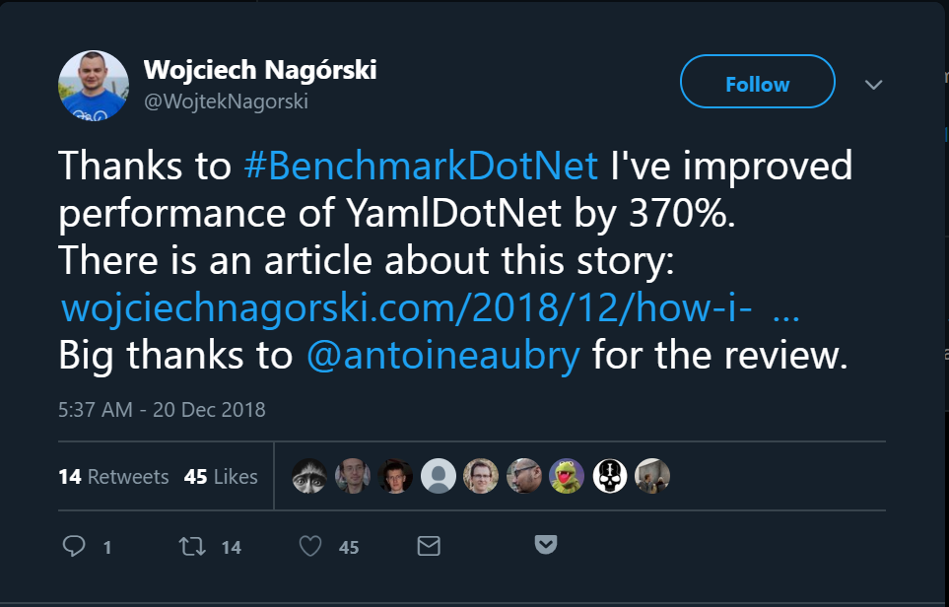
@lukaszpyrzyk

Slide 34
Issue #3 Relying on the object state

Slide 35
Code
static void Main(string[] args)
{
var timer = new Timer(x => Console.WriteLine(DateTime.UtcNow), null, 0, 100);
Console.WriteLine("Timer started?");
GC.Collect();
Console.Read();
}

Slide 36
debug
dotnet run -c Debug
14/10/2019 18:43:22
Timer started?
14/10/2019 18:43:22
14/10/2019 18:43:22
14/10/2019 18:43:22
[…]

Slide 37
release
dotnet run -c Release
Timer started?
14/10/2019 18:48:56

Slide 38
Eager root collection it is a Just-in-time compiler optimization which makes local references irrelevant after their last usage

Slide 39
keep alive
static void Main(string[] args)
{
var timer = new Timer(x => Console.WriteLine(DateTime.UtcNow), null, 0, 100);
Console.WriteLine("Timer started?");
GC.Collect();
Console.Read();
GC.KeepAlive(timer);
}

Slide 40
Calling dispose
static void Main(string[] args)
{
var timer = new Timer(x => Console.WriteLine(DateTime.UtcNow), null, 0, 100);
Console.WriteLine("Timer started?");
GC.Collect();
Console.Read();
timer.Dispose();
}

Slide 41
Calling dispose
static void Main(string[] args)
{
using (var timer = new Timer(x => Console.WriteLine(DateTime.UtcNow), null, 0, 100))
{
Console.WriteLine("Timer started?");
GC.Collect();
Console.Read();
}
}

Slide 42
Calling dispose
C# 8.0

Slide 43
Calling dispose
static void Main(string[] args)
{
using var timer = new Timer(x => Console.WriteLine(DateTime.UtcNow), null, 0, 100);
Console.WriteLine("Timer started?");
GC.Collect();
Console.Read();
}

Slide 44
Calling dispose
[NullableContext(1)]
[Nullable(0)]
public sealed class Timer : MarshalByRefObject, IAsyncDisposable, Idisposable { /// <summary>Releases all resources used by the current instance of <see cref="T:System.Threading.Timer" />.</summary>
/// <returns>A <see cref="T:System.Threading.Tasks.ValueTask" /> that completes when all work associated with the timer has ceased.</returns>
public ValueTask DisposeAsync();
}

Slide 45
Calling dispose
static async Task Main(string[] args)
{
await using var timer = new Timer(x => Console.WriteLine(DateTime.UtcNow), null, 0, 100);
Console.WriteLine("Timer started?");
GC.Collect();
Console.Read();
}

Slide 46


Slide 47
Code
static void Main(string[] args)
{
var timer = new Timer(x => Console.WriteLine(DateTime.UtcNow), null, 0, 100);
Console.WriteLine("Timer started?");
GC.Collect();
Console.Read();
}

Slide 48
release
dotnet run -c Release Timer started?
16/10/2019 16:36:51
16/10/2019 16:36:51
16/10/2019 16:36:51
16/10/2019 16:36:51
16/10/2019 16:36:51
16/10/2019 16:36:51
16/10/2019 16:36:51
[..]

Slide 49
What?

Slide 50
Issue #4 forgetting about tiered compilation

Slide 51
.NET Core version | Tiered compilation
2.0 | None
2.1 | Optional
3.0 | Default

Slide 52
release
<Project Sdk="Microsoft.NET.Sdk">
<PropertyGroup>
<OutputType>Exe</OutputType>
<TargetFramework>netcoreapp2.1</TargetFramework>
<TieredCompilation>true</TieredCompilation>
</PropertyGroup>
</Project>

Slide 53
release
<Project Sdk="Microsoft.NET.Sdk">
<PropertyGroup>
<OutputType>Exe</OutputType>
<TargetFramework>netcoreapp3.0</TargetFramework>
</PropertyGroup>
</Project>

Slide 54


Slide 55
tiered compilation can influence the profiling and benchmarking results. It can change results of samples from books or blog posts
@lukaszpyrzyk

Slide 57

@lukaszpyrzyk

Slide 58
public class TelemetryEntry
{
public DateTimeOffset Timestamp { get; set; }
public int UserId { get; set; }
}
@lukaszpyrzyk

Slide 59
[Route("[controller]")]
[ApiController]
public class TelemetryController : Controller
{
[HttpPut]
public async Task<IActionResult> Insert([FromServices] DataStorageService db)
{
var entry = CreateEntry();
await db.Insert(entry);
return NoContent();
}
}
@lukaszpyrzyk

Slide 60
public class DataStorageService
{
private readonly DataStorageServiceOptions _options; private readonly DocumentClient _client;
public SlowDataStorageService(DataStorageServiceOptions options)
{
_options = options;
_client = new DocumentClient(options.Endpoint, options.ApiKey);
_client.CreateDatabaseIfNotExistsAsync(new Database { Id = options.DatabaseName }).GetAwaiter().GetResult();
_client.CreateDocumentCollectionIfNotExistsAsync(
UriFactory.CreateDatabaseUri(options.DatabaseName),
new DocumentCollection { Id = options.CollectionName })
.GetAwaiter().GetResult();
}
}
GetAwaiter().GetResult();
GetAwaiter().GetResult()
@lukaszpyrzyk

Slide 61
public async Task Insert(TelemetryEntry telemetryEntry)
{
var collectionUri = UriFactory.CreateDocumentCollectionUri(_options.DatabaseName, _options.CollectionName);
await _client.CreateDocumentAsync(collectionUri, telemetryEntry);
}
CreateDocumentCollectionUri
@lukaszpyrzyk

Slide 62
public void ConfigureServices(IServiceCollection services)
{
var dbOptions = GetOptions();
services.AddSingleton(dbOptions);
services.AddTransient<DataStorageService>();
}
AddTransient
@lukaszpyrzyk

Slide 63
testing
How many entries can be saved?
“wrk -t1 -c1 -d30s http://localhost:5000/telemetry/insert/”
@lukaszpyrzyk

Slide 64
Testing – no docs
Running 30s test @ http://localhost:5000/telemetry/insert/slow
1 threads and 1 connections
Thread Stats Avg Stdev Max +/- Stdev
Latency 876.89ms 45.82ms 993.87ms 76.47%
Req/Sec 0.88 0.33 1.00 88.24%
34 requests in 30.07s, 2.69KB read
Requests/sec: 1.13
Transfer/sec: 91.57B
@lukaszpyrzyk

Slide 65
IT SUCKS
@lukaszpyrzyk

Slide 66
public class AsyncLazy<T> : Lazy<Task<T>>
{
public AsyncLazy(Func<Task<T>> valueFactory) : base(valueFactory)
{
}
}
@lukaszpyrzyk

Slide 67
public class DataStorageService
{
private readonly AsyncLazy<DocumentClient> _clientFactory; private readonly Uri _collectionUri;
public DataStorageService(DataStorageServiceOptions options)
{
_collectionUri = UriFactory.CreateDocumentCollectionUri(options.DatabaseName, options.CollectionName);
_clientFactory = new AsyncLazy<DocumentClient>(async () =>
{
var client = new DocumentClient(options.Endpoint, options.ApiKey);
await InitialDatabase(client, options);
});
}
}
@lukaszpyrzyk

Slide 68
public async Task Insert(TelemetryEntry telemetryEntry)
{
var client = await _clientFactory.Value;
await client.CreateDocumentAsync(_collectionUri, telemetryEntry);
}
@lukaszpyrzyk

Slide 69
public void ConfigureServices(IServiceCollection services)
{
var dbOptions = GetOptions();
services.AddSingleton(dbOptions);
services.AddSingleton<DataStorageService>();
}
@lukaszpyrzyk

Slide 70
Testing - optimizations
@lukaszpyrzyk

Slide 71
_clientFactory = new AsyncLazy<DocumentClient>(async () =>
{
var client = new DocumentClient(options.Endpoint, options.ApiKey, new ConnectionPolicy
{
ConnectionMode = ConnectionMode.Direct,
ConnectionProtocol = Protocol.Tcp
});
await InitialDatabase(client, options);
});
@lukaszpyrzyk

Slide 72
Testing – direct / tcp
@lukaszpyrzyk

Slide 73

The gone fuckup story
Microservices
CosmosDB
Migration to the Direct/TCP connection, feature toggle
Thousands of the GoneException saying “The requested resource is no longer available at the server”
We have a bug!!!
Race condition? Dispose? Network down? Firewall?
@lukaszpyrzyk

Slide 74

@lukaszpyrzyk

Slide 75
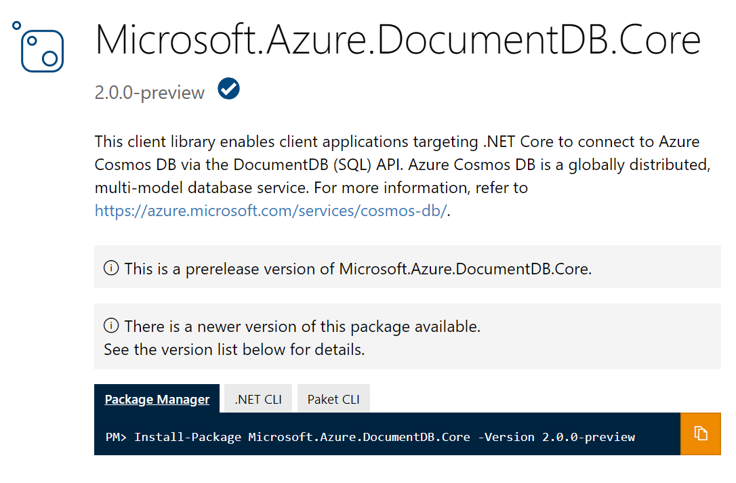
@lukaszpyrzyk

Slide 76
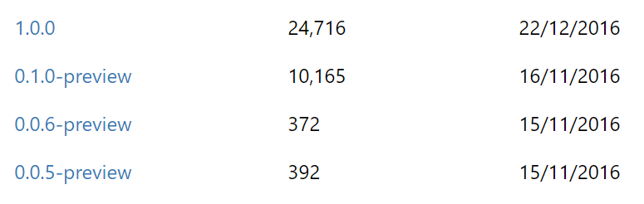
@lukaszpyrzyk

Slide 77
The gone fuckup story
GoneException(“The requested resource is no longer available at the server”)
might be
PlatformNotSupportedException();
@lukaszpyrzyk

Slide 78
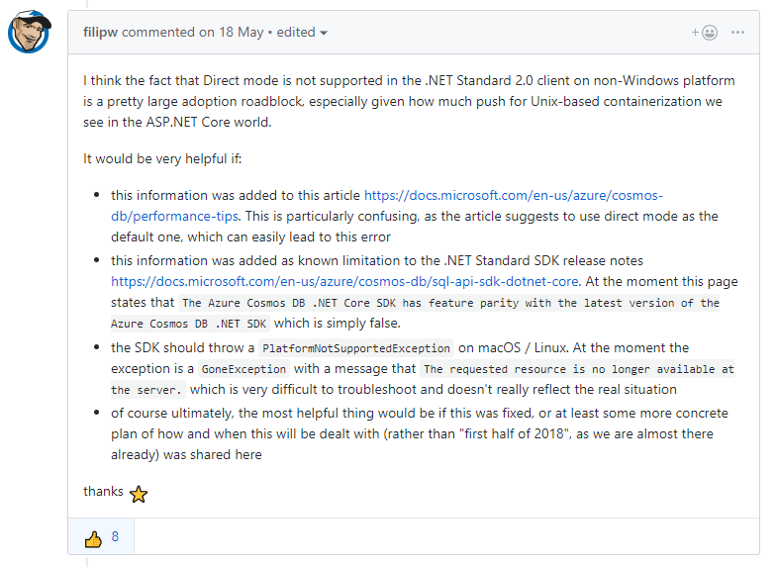
https://github.com/Azure/azure-cosmosdb-dotnet/issues/194
@lukaszpyrzyk

Slide 79
Fuckup #3 Buffering responses
@lukaszpyrzyk

Slide 80
Buffering a file
Github
blob
User
https://github.com/dotnet/corefx/archive/v2.2.0-preview3.zip
@lukaszpyrzyk

Slide 81
Buffering a file
Github
blob
Server
User
http://localhost:5000/download/
@lukaszpyrzyk

Slide 82
Buffering a file
public async Task<IActionResult> WithBuffering()
{
var request = new HttpRequestMessage(HttpMethod.Get, "dotnet/corefx/archive/v2.2.0-preview3.zip");
var response = await _client.Client.SendAsync(request);
var stream = await response.Content.ReadAsStreamAsync();
var contentType = response.Content.Headers.ContentType.MediaType;
return new FileStreamResult(stream, contentType);
}
@lukaszpyrzyk

Slide 83
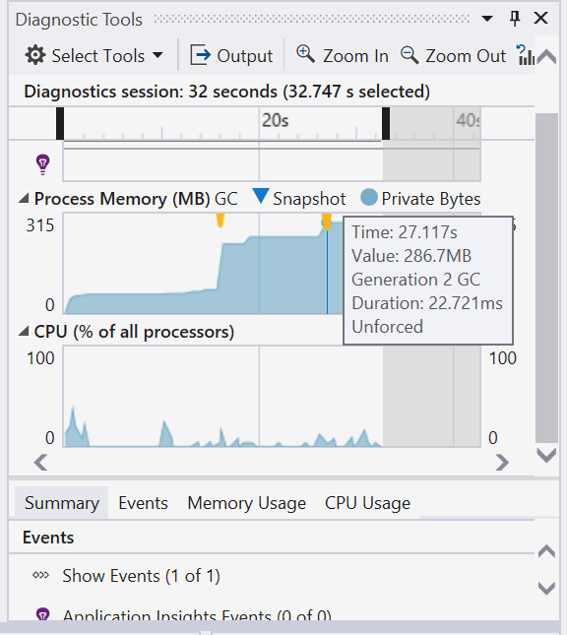
@lukaszpyrzyk

Slide 84
Buffering a file
public async Task<IActionResult> WithoutBuffering()
{
var request = new HttpRequestMessage(HttpMethod.Get, "dotnet/corefx/archive/v2.2.0-preview3.zip");
var response = await _client.Client.SendAsync(request, HttpCompletionOption.ResponseHeadersRead);
var stream = await response.Content.ReadAsStreamAsync();
var contentType = response.Content.Headers.ContentType.MediaType;
return new FileStreamResult(stream, contentType);
}
@lukaszpyrzyk

Slide 85
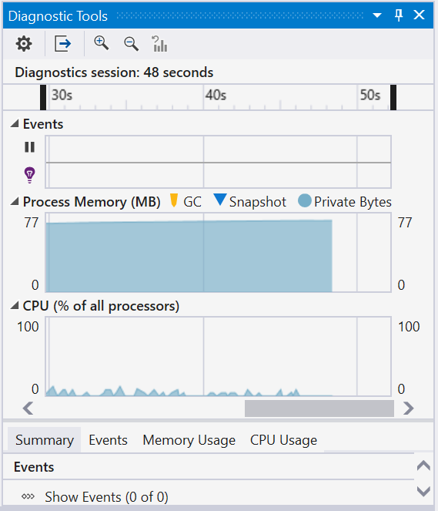
@lukaszpyrzyk

Slide 86
Buffering a file
public async Task<Stream> Stream()
{
var request = new HttpRequestMessage(HttpMethod.Get, "dotnet/corefx/archive/v2.2.0-preview3.zip");
var response = await _client.Client.GetStreamAsync(request.RequestUri);
return response;
}
@lukaszpyrzyk

Slide 87
TIP Don’t buffer big responses. Stream them
@lukaszpyrzyk

Slide 88
Fuckup #5 Let’s optimize it
@lukaszpyrzyk

Slide 89
The business problem
JIRA #2312 PoC of the new business feature
@lukaszpyrzyk

Slide 90

The business problem
This is very important for our company
It’s PoC
Please make it ASAP
Performance doesn’t matter
Don’t spend to much time on it
Keep clean and easy to understand for another developers
@lukaszpyrzyk

Slide 91
The business problem
KEEP
IT
SIMPLE
STUPID
@lukaszpyrzyk

Slide 92
public ulong SecretAlgorithm(ulong n)
{
if (n == 1 || n == 2) return 1;
return SecretAlgorithm(n - 2) + SecretAlgorithm(n - 1);
}
@lukaszpyrzyk

Slide 93
public ulong Fibonacci(ulong n)
{
if (n == 1 || n == 2) return 1;
return Fibonacci(n - 2) + Fibonacci(n - 1);
}
@lukaszpyrzyk

Slide 94

The business problem
It works
It is simple
@lukaszpyrzyk

Slide 95
The business problem
Make it faster!
@lukaszpyrzyk

Slide 96
The business problem
What kind of optimizations techniques do I know?
@lukaszpyrzyk

Slide 97
The business problem
THREADS FOR THE RESQUE
@lukaszpyrzyk

Slide 98
public ulong Fibonacci(ulong n)
{
if (n == 1 || n == 2) return 1;
var a = Task.Run(() => Fibonacci(n - 2));
var b = Task.Run(() => Fibonacci(n - 1));
Task.WaitAll(a, b);
return a.Result + b.Result;
}
@lukaszpyrzyk

Slide 99
@lukaszpyrzyk

Slide 100
LESS
THREADS
@lukaszpyrzyk

Slide 101
public ulong Fibonacci(ulong n)
{
if (n == 1 || n == 2) return 1;
var a = Task.Run(() => FibonacciImplementation(n - 2));
var b = Task.Run(() => FibonacciImplementation(n - 1));
Task.WaitAll(a, b);
return a.Result + b.Result;
}
private ulong FibonacciImplementation(ulong n)
{
if (n == 1 || n == 2) return 1;
return Recursive(n - 2) + Recursive(n - 1);
}
@lukaszpyrzyk

Slide 102
@lukaszpyrzyk

Slide 103
@lukaszpyrzyk

Slide 104
LET’S THINK
@lukaszpyrzyk

Slide 105
public static ulong Recursive(ulong n)
{
Console.WriteLine($"Calculating Fibonacci for {n}");
if (n == 1 || n == 2) return 1;
return Recursive(n - 2) + Recursive(n - 1);
}
@lukaszpyrzyk

Slide 106
Fibonacci(5);
Calculating Fibonacci for 5
Calculating Fibonacci for 3
Calculating Fibonacci for 1
Calculating Fibonacci for 2
Calculating Fibonacci for 4
Calculating Fibonacci for 2
Calculating Fibonacci for 3
Calculating Fibonacci for 1
Calculating Fibonacci for 2
@lukaszpyrzyk

Slide 107
WE DO THE SAME JOB
SEVERAL TIMES

Slide 108
Memoization
It is an optimization technique used primarily to speed up computer programs by storing the results of expensive function calls and returning the cached result when the same inputs occur again
@lukaszpyrzyk

Slide 109
Memoization
public ulong Fibonacci(ulong n)
{
if (n == 1 || n == 2) return 1;
var results = new ulong[n];
results[0] = 1;
results[1] = 1;
return FibWithMemoization(n, results);
}
@lukaszpyrzyk

Slide 110
Memoization
private static ulong FibWithMemoization(ulong n, ulong[] results)
{
var current = n - 1;
var previous = current - 1;
var beforePrevious = previous - 1;
if (results[beforePrevious] == 0)
results[beforePrevious] = FibWithMemoization(previous, results);
if (results[previous] == 0)
results[previous] = FibWithMemoization(current, results);
results[current] = results[beforePrevious] + results[previous];
return results[n - 1];
}
@lukaszpyrzyk

Slide 111
@lukaszpyrzyk

Slide 112
@lukaszpyrzyk

Slide 113
@lukaszpyrzyk

Slide 114

@lukaszpyrzyk

Slide 115
The business problem
Calculate Fibonacci sequence
Write recursion
Optimize it with parallel execution
Optimize it with data structures
@lukaszpyrzyk

Slide 116
The business problem
WHAT WE MISSED?
@lukaszpyrzyk

Slide 117
The business problem
Calculate Fibonacci sequence
Write recursion
Optimize it with parallel execution
Optimize it with data structures
@lukaszpyrzyk

Slide 118
public ulong Fibonacci(ulong n)
{
if (n == 1 || n == 2) return 1;
ulong a = 1, b = 1;
for (ulong i = 2; i < n; i++)
{
ulong temp = a + b;
a = b;
b = temp;
}
return b;
}
@lukaszpyrzyk

Slide 119
@lukaszpyrzyk

Slide 120
@lukaszpyrzyk

Slide 121
TIP before doing optimizations Make sure that current solution still fits
@lukaszpyrzyk

Slide 122
TIP There are faster algorithms to calculate fibonnaci sequence like Matrix exponentiation or Fast doubling
@lukaszpyrzyk
Notes:
Eksponenta macierzy
Szybkie podwajanie

Slide 123
Summary
There are no projects without performance fuckups
They can be huge or small, but they are.
@lukaszpyrzyk

Slide 124
Summary
YOU MIGHT HAVE NO TIME TO FIX IT.
IT’S OKAY.
@lukaszpyrzyk

Slide 125
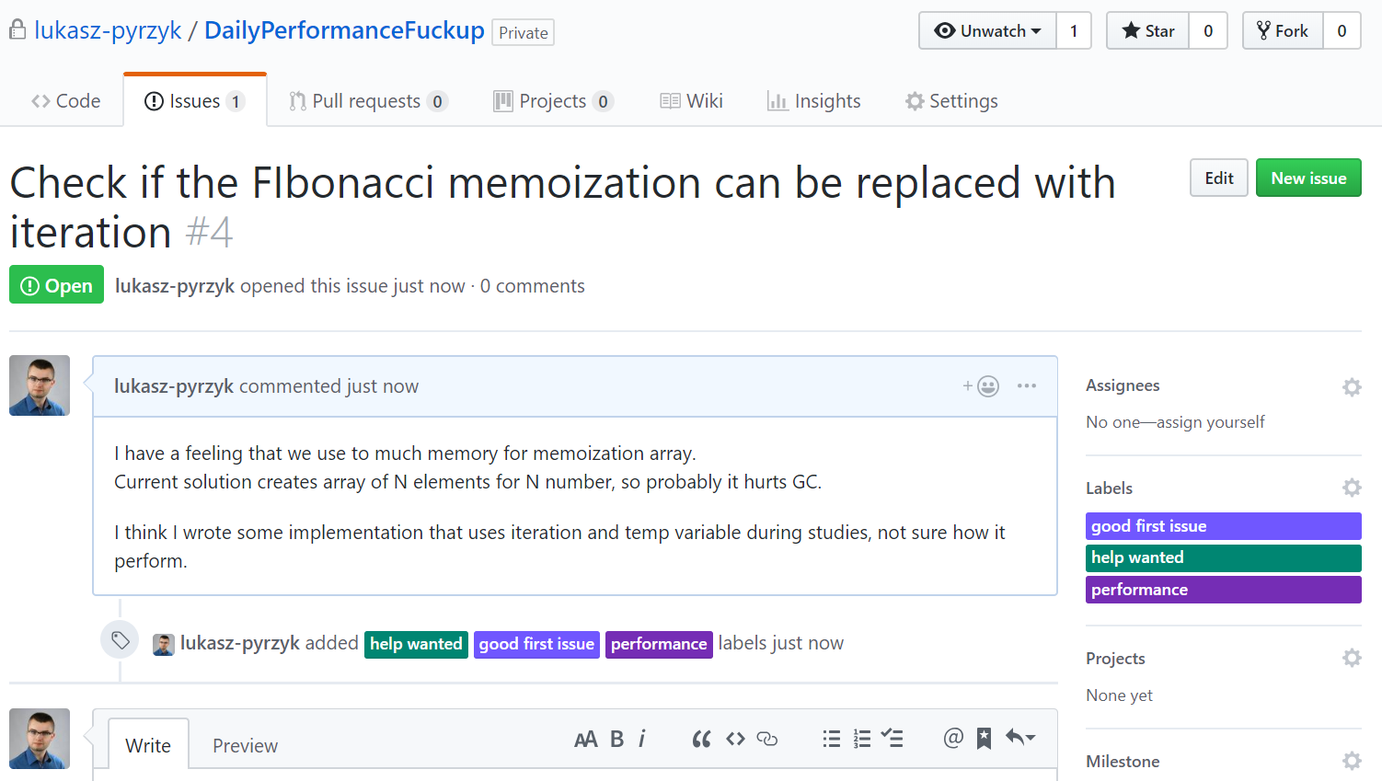
@lukaszpyrzyk

Slide 126
Links
https://github.com/lukasz-pyrzyk/DailyPerformanceFuckup
https://docs.microsoft.com/en-us/azure/cosmos-db/performance-tips
https://docs.microsoft.com/en-us/azure/cosmos-db/sql-api-sql-query-metricshttp://www.tugberkugurlu.com/archive/efficiently-streaming-large-http-responses-with-httpclient
https://github.com/davidfowl/AspNetCoreDiagnosticScenarios
https://wojciechnagorski.com/2018/12/how-i-improved-the-yamldotnet-performance-by-370/
https://github.com/aaubry/YamlDotNet/pull/356
@lukaszpyrzyk

Slide 127
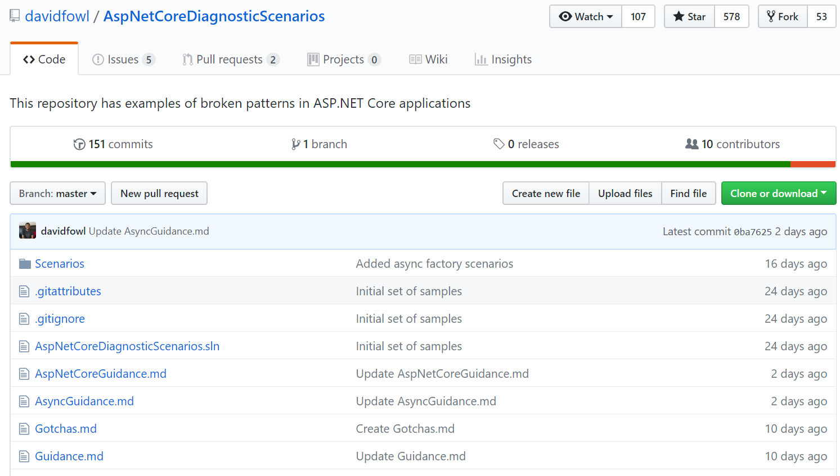
@lukaszpyrzyk

Slide 128

10-11 October 2019
Warsaw - Poland
dotnetos.org

Slide 129
Thank you!
@lukaszpyrzyk
lukasz.pyrzyk@gmail.com

